Slide 1
Lecture 1: Introduction
Notes:
http://ares.southernct.edu/organizations/rccs/
http://plato.stanford.edu/entries/ethics-computer/
Slide <number>

Slide 2
Overview
Aims & requirements:
Providing students understandings about Computer ethics.
Requirements:
- Reading materials before the lecture
- Attending required
Lecturing format:
  Content: Basic concepts in computer ethics
  Discussion: Importance of computer ethics?
  Self-study: areas of IT
  Exercise: Finding and summarizing a paper in computer ethics.
Reading material: Part 1, Textbook

Slide 3
Information Technology
Definition: Devices used in creation, storage, manipulation, dissemination of data, sound, and/or images
Examples: Computers, telephones, video cameras, MP3 players
People making greater use of IT
  Costs keep falling
  Capabilities keep rising

Slide 4
Information Technology
Computing technology is the most powerful and most flexible technology ever devised.
It is universal tools since its logical malleability

Slide 5
Notes: Computers’ features
Computers are logical malleability
  Computer can manipulated for different purposes depending on inputs and desired outputs.
Computers are informationally enriching
  Many new concepts raised following computers
  Creditcards, computer added machines, …
Notes:
malleability = mem deo
Slide <number>

Slide 6
IT Issues
Email
  Easy way to keep in touch
  Spam has become a real problem
Web
  Free access to huge amounts of information
  Harmful consequences of some sites
CDs, MP3s
  Free or cheap copies readily available
  May be unfair to musicians

Slide 7
IT Issues
Credit cards
  Convenience over cash and checks
  Increases possibility of identity theft
  Who owns information about transactions?
Telecommuting
  Saves time, allows more flexible work hours
  Can lead to longer work hours
  May result in fewer chances for promotion

Slide 8
The Need of Professional Ethics
We adopt a new technology because it promises to solve a problem we are facing, but sometimes its use creates yet another problem.
That doesn’t mean we should never adopt a new technology, but it does give us a good reason why we should be making informed decisions, weighing the benefits and potential harms associated with the use of new devices.

Slide 9
Definition of Computer Ethics
Ethics: a way to decide the best thing to do
A central task of Computer Ethics is to determine what we should do in such cases, that is, formulate policies to guide our actions (John Moor)
Computer ethics should be viewed as a branch of professional ethics, concerned primarily with standards of good practice and codes of conduct for computing professionals (Donald Gotterbarn )

Slide 10
Definition of Computer Ethics
Computer ethics has two parts:
  (i) the analysis of the nature and social impact of computer technology and
  (ii) the corresponding formulation and justification of policies for the ethical use of such technology.

Slide 11
Topics in Computer ethics
Computers in the Workplace
Computer Crime
Privacy and Anonymity
Intellectual Property
Professional Responsibility
Others: Globalization and the Metaethics of Computer Ethics

Slide 12
Ethical responsibility
Ethical responsibility begins by taking the ethical point of view.
We must respect others and their core values. If we can avoid policies that result in significant harm to others, that would be a good beginning toward responsible ethical conduct.
Some policies are so obviously harmful that they are readily rejected by our core-value standards.
  Selling computer software which is known to malfunction in a way which is likely to result in death is an obvious example.
  Other policies easily meet our standards. Building computer interfaces which facilitate use by the disabled is a clear example

Slide 13
Characteristics of a Profession
Initial professional education—formal course work completed by candidates before they begin practicing the profession
Accreditation—assures that the formal course work meets the standards of the profession
Skills development—activities that provide candidates with the opportunity to gain practical skills needed to practice the profession
Certification—process by which candidates are evaluated to determine their readiness to enter the profession

Slide 14
Characteristics of a Profession
Licensing—the process giving candidates the legal right to practice the profession
Professional development —formal course work completed by professionals in order to maintain and develop their knowledge and skills
Code of ethics —mechanism by which a profession ensures that its members will use their knowledge and skills for the benefit of society
Professional society —organization promoting the welfare of the profession, typically consisting of most if not all of the members of the profession

Slide 15
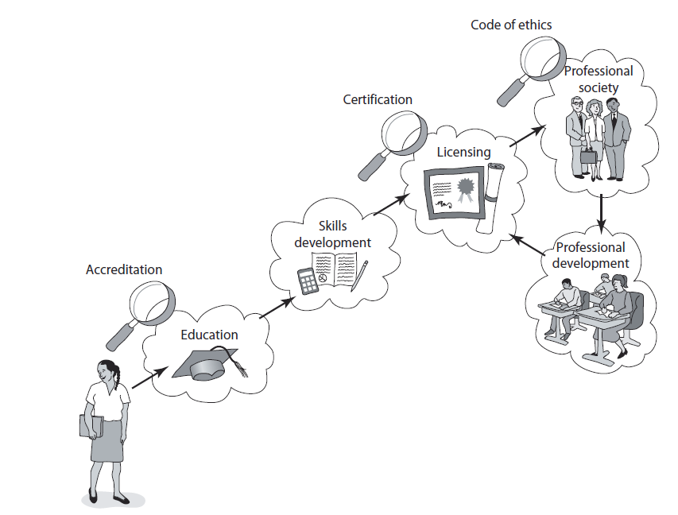

<number>/63

Slide 16
Why computer ethics?
Level 1: We should study CE because doing so will make us behave like responsible professionals.
Level 2: We should study CE because doing so will teach us how to avoid computer abuse and catastrophes.

Slide 17
Why computer ethics?
Level 3: We should study CE because the advance of computing technology will continue to create temporary policy vacuums.
Level 4: We should study CE because the use of computing permanently transforms ethical issues to the degree that their alternations require independent study.

Slide 18
Why computer ethics?
Level 5: We should study CE because the use of computing technology creates, and will continue to create novel ethical issues that require special study.
Level 6: We should study CE because of the set of novel and transformed issues is large enough and coherent to define a new field.

Slide 19
Unique ethical features in IT
Uniquely stored
Malleable
Complex
Fast
Cheap
Cloned
Discrete
Coded

Slide 20
Ethical decision making: Issues
A typical problem in computer ethics arises because there is policy vacuum about how computer technology should be used.
For a new policy, there are four factors being considered:
  What is a policy for conduct or a policy vacuum to guide our actions?
  How does one determine whether there are existing policies that adequately cover situation in question?
  How does one formulate new policies to deal with new situations that existing policies are unable to resolve?
  How does one ethically justify newly formulated policies?

Slide 21
Policies to guide conduct
International treaties and agreements
Laws
Regulations
Standards of good practice
Professional codes of ethics
Corporate policies
Community and personal values

Slide 22
Method for ethical case analysis
Step 1: Take the ethnical point of view
  Involving adoption of a perspective on equality, justice and respect
  Determine whether an action or policy is ethically acceptable.
Step 2: Develop a detailed description of the case to be analyzed

Slide 23
Method of ethical case analysis
Step 3: Try to see the ethical issues and any traditional solutions that fit the case.
Step 4: Call upon your own ethical knowledge and skills
  Think of precedents and analogies
  Make use of your natural sensitivity about giving offence.
  Engage in role playing and apply your natural ability to sympathize

Slide 24
Method of ethical case analysis
Step 5: Get advices from others
Step 6: Take advantage form one or more systematic analysis techniques if the above 5 steps are not enough

Slide 25
Method of ethical case analysis
Step 7: Draw relevant ethical conclusions about the case
Step 8: Draw relevant lessons about the future.

Slide 26
Review questions
  What is computer ethics?
  What are core values related to computer ethics?
  Levels of justification for computer ethics
  Steps in analyzing cases related to computer ethics?

